Slide 1
while loop

Slide 2
Objectives
This chapter introduces:
Basic usage of while loop
Comparison of for loop and while loop
Use break statement in while loop
Generate random numbers in while loop

Slide 3
while loop
The while loop in Python can also be used to iterate over a sequence (a list, a tuple, a string) or other iterable objects
The difference between while loop and for loop :
while loop is often used to repeat a specific block of code an unknown number of times
for loop is often used to repeat a specific block of code a known number of times

Slide 4
while loop
Syntax:
while (condition): #the execution condition of while loop
Declarative sentence

Slide 5
Indentation
In the while loop statement, different indentation may have different output results

Slide 6
Indentation
E.g1:
count = 0
while (count < 9):
#use while loop to display the number from 0 to 8
print ("The count is:", count)
count = count + 1
# display ‘’Good bye’’ after printing out a number
print ("Good bye!")

Slide 7
Indentation
E.g2:
count = 0
while (count < 9):
#use while loop to display the number from 0 to 8
print ("The count is:", count)
count = count + 1
#display "Good bye!” after completing the while loop
print ("Good bye!")

Slide 8
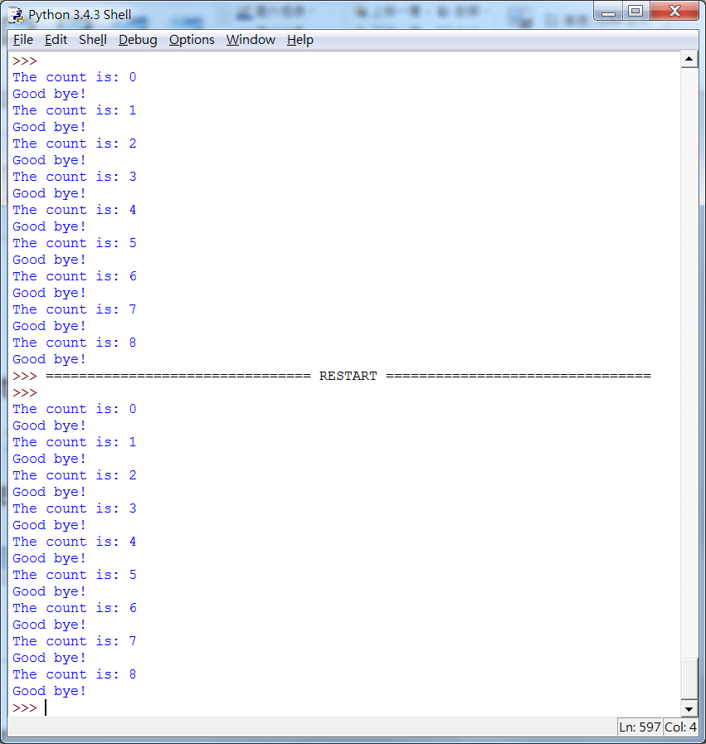
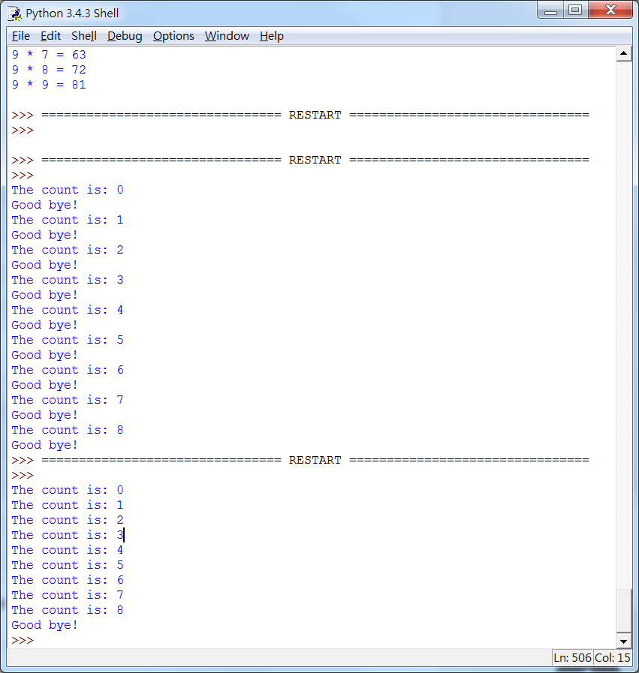
Indentation
Different indentation may have different results
Wrong indentation may have logical errors
E.g1:
E.g2:

Slide 9
while loop and for loop
Both of while loop and for loop can be used if the number of executions is known
Using the for loop is more concise

Slide 10
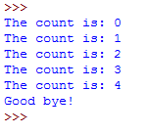
while loop and for loop
Example with while loop :
Result:
count = 0
while (count<5):
#use while loop to display the number from 0 to 4
print ("The count is:", count)
count = count + 1
#display "Good bye!” after completing the while loop
print ("Good bye!")

Slide 11
while loop and for loop
Example with for loop :
Result:
for count in range(0,5):
#use for loop to display the number from 0 to 4
print ("The count is:", count)
# display "Good bye!” after completing the for loop
print ("Good bye!")

Slide 12
break
The following example allows the user to enter a value multiple times until the conditional expression is true
When the conditional expression is true, the program will execute break statement and exit the while loop

Slide 13
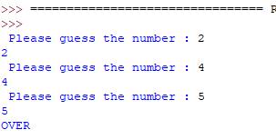
break
E.g:
Result:
while (1):
guess=int (input(" Please guess the number :"))
print(guess)
if(guess==5):#Conditional expression
break
print("OVER\n")

Slide 14
random number
Use while loop with if...else... and random number generator to create a mini game for guessing a number

Slide 15
Guess the number
E.g:
min=0
max=100
ans=5 #set the answer to 5
while (1):
print(" Please guess the numbers ")
print(min, "~",max) #display the range from min to max
guess=int (input())#read data from the user input
if(guess==ans):#guess the right answer, then end the loop
print(" bingo ")
break;
else:#if wrong, continue to guess and update the range
if(guess>ans):
max=guess
else:
min=guess
print(" game over ")

Slide 16
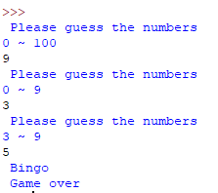
Guess the number
Result:

Slide 17
Random number
Use the random number generator to generate a random number

Slide 18
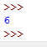
Random number
E.g:
Result:
#load library
from random import randint
#random number is generated in the range between 5 and 10,
#including 5 and 10
ans = randint(5,10)
print(ans)

Slide 19
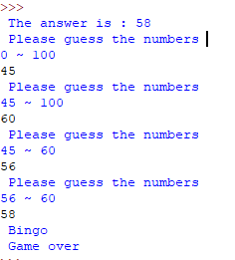
Guess the number
Below is the result of the number guess game after using the random number generator to set the value of the answer variable
Result:

Slide 20
Source
References:
http://openhome.cc/Gossip/Python/IOABC.html
http://www.pythondoc.com/pythontutorial3/introduction.html
http://pydoing.blogspot.tw/2011/01/python-operator.html
Python深入淺出程式設計

Slide 21
Exercise 1
Design a program that allows the user to select:
Select 1: display the addition of 2 numbers
Select 2: display the subtraction of 2 numbers
Select 3: display the multiplication of 2 numbers
Select 4: display the division of 2 numbers
Select -1: exit the program
For each selection of 1, 2, 3, or 4, enter 2 numbers and show the result

Slide 22
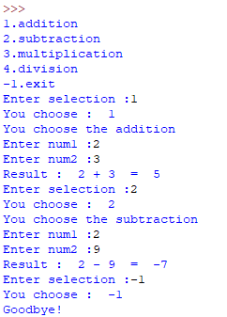
Exercise (conti.)
User input:
1
2
3
2
2
9
-1
Result:

Slide 23
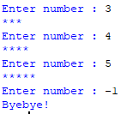
Exercise 2
Please write a program that will repeatedly ask the user to input one positive number until the input number is not positive. When a positive number n is inputted, print n stars on your screen.
E.g:

Slide 24
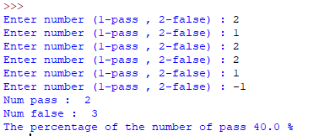
Exercise 3
Please write a program that will repeatedly ask the user to input 1(Pass) or 2(Failure), until the input is -1. After -1 is inputted, display the numbers of Passes and Failures, and the percentage of the number of Passes to the number of all inputted Pass or Failure data (1 or 2).
E.g:

